Slide 1

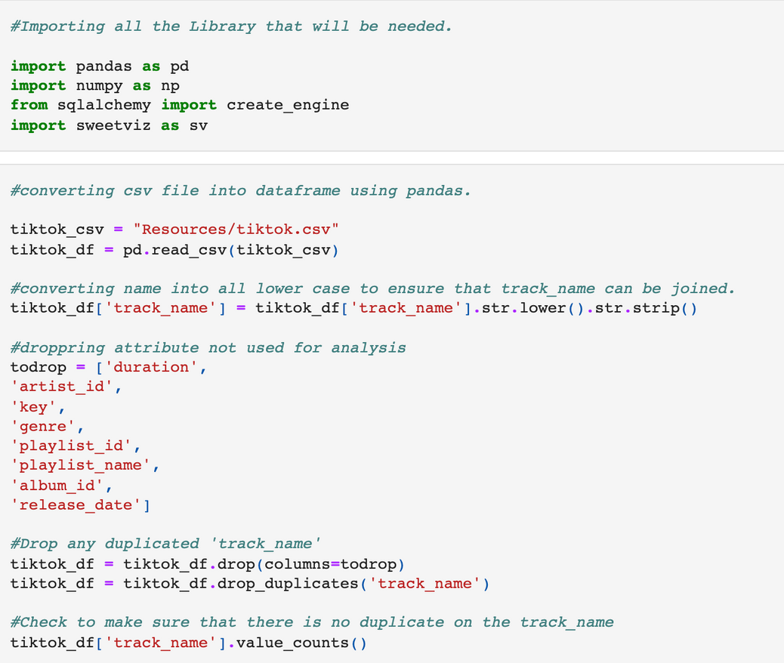
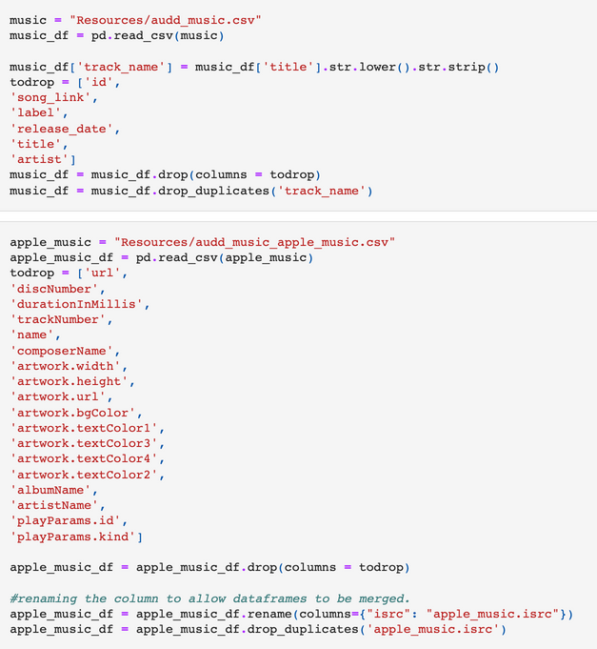


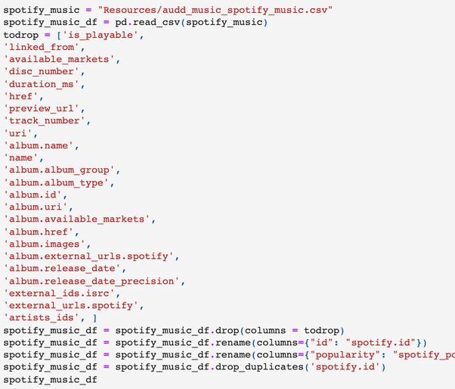
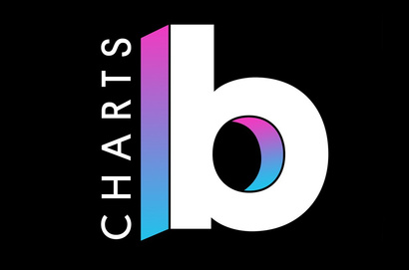

Transform TikTok Music Trends Data
We created individual data frames to clean and organize the information provided for TikTok's trending music, trending videos, and the Apple/Spotify data provided for those songs
Next

Slide 2
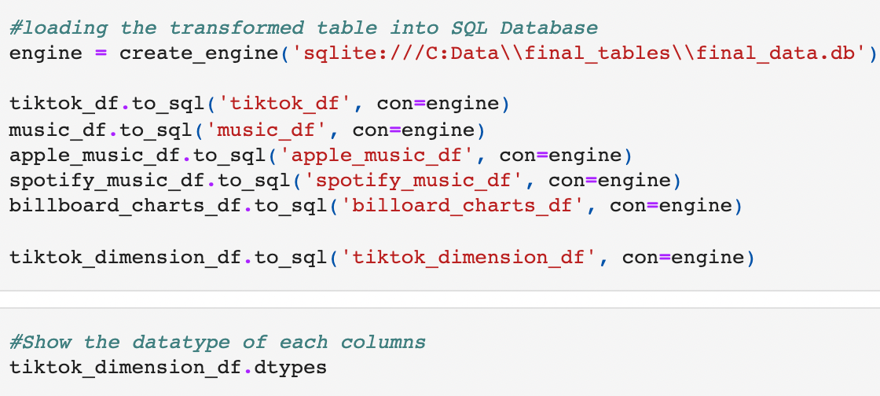
LOAD
Database | SQL
All data was uploaded in SQL and contains six tables for use:
Apple Music Data
Spotify Music Data
Billboard Charts Data
TikTok Trending Music Data
TikTok Trending Videos Data
Final TikTok
Next

